Slide 1
Chat to Game Generator Interface
By Christopher Figueroa

Slide 2

Abstract
Inspired by ChatGPT and Rix AI
Generates a game using a text interface
Goals of game generator:
Real-time video game editing
Direct compilation of AI code
Dynamic editing of existing code
Uses Python for game generation
Well suited for 2D game generation
Juno spacecraft in orbit around Jupiter

Slide 3
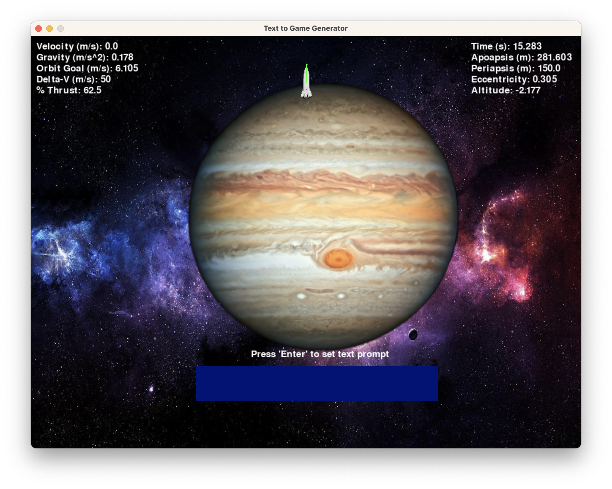
Motivation
Compare the 2D game generation methods
Three generation methods:
Hard-coded instructions
OpenAI interface
Dynamic code editing
Demonstrate feasibility of a prompt-based 2D game engine
Keep number of libraries to a minimum
Project game randomized planet Mars
Hard-coded planet orbiter game

Slide 4
Related Research - ChatGPT
OpenAI, founded in 2015 by Elon Musk and Sam Altman.
ChatGPT generates natural language text, pre-training on large text an unsupervised manner.
Pre-training involves predicting the next word in a sequence, allowing the model to learn language patterns, syntax, grammar, and semantics.
Fine-tuning on specific tasks is done with smaller labeled datasets, updating the model for tasks like text classification or question-answering.
GPT-1 had 117 million parameters and demonstrated impressive results in various natural language processing tasks.
GPT-4 is a large multimodal language model accepting both image and text inputs, generating text outputs.
Western Michigan University Earth Orbit[1]

Slide 5
Related Research - Alpaca
Developed by Stanford University researchers, Alpaca is an open-source language model based on Meta's Llama.
Not available for commercial use, but small businesses can use it for chatbot development.
Tested against ChatGPT in tasks like email creation, social media, and productivity tools.
Alpaca won 90 times, while ChatGPT won 89 times.
Applicable in real-world scenarios, aiding researchers in ethical AI and cybersecurity (e.g., scam detection).
Alpaca allows for training sophisticated language models without expensive hardware concerns.

Slide 6
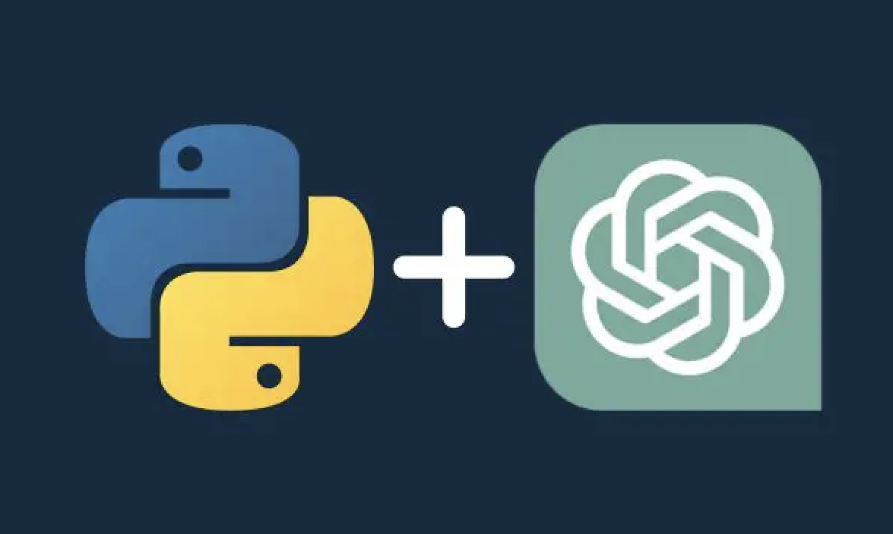
Python Libraries Used
2D Python game engine
Base game libraries:
Pygame
Math
Numpy
ChatGPT libraries:
Sys (already included)
OpenAI
Compiled in command prompt
Python 3.11.5
Python Anaconda Navigator Mac OS

Slide 7
Three Game Generation Methods
Hard-coded instructions:
Uses the Planet Orbiter game as default base game
Text-based user input to edit existing planets and newly added planets
Procedurally generated planets and background
OpenAI interface:
Takes in input from player to send prompts to ChatGPT
Uses OpenAI library to run the output of ChatGPT in Python
Allows user to edit existing games as well as newly generated games
Dynamic code editing:
Uses the game Pong as the default base game
Stores the existing game code as a string
Identifies keywords in user input to identify the desired code alterations

Slide 8
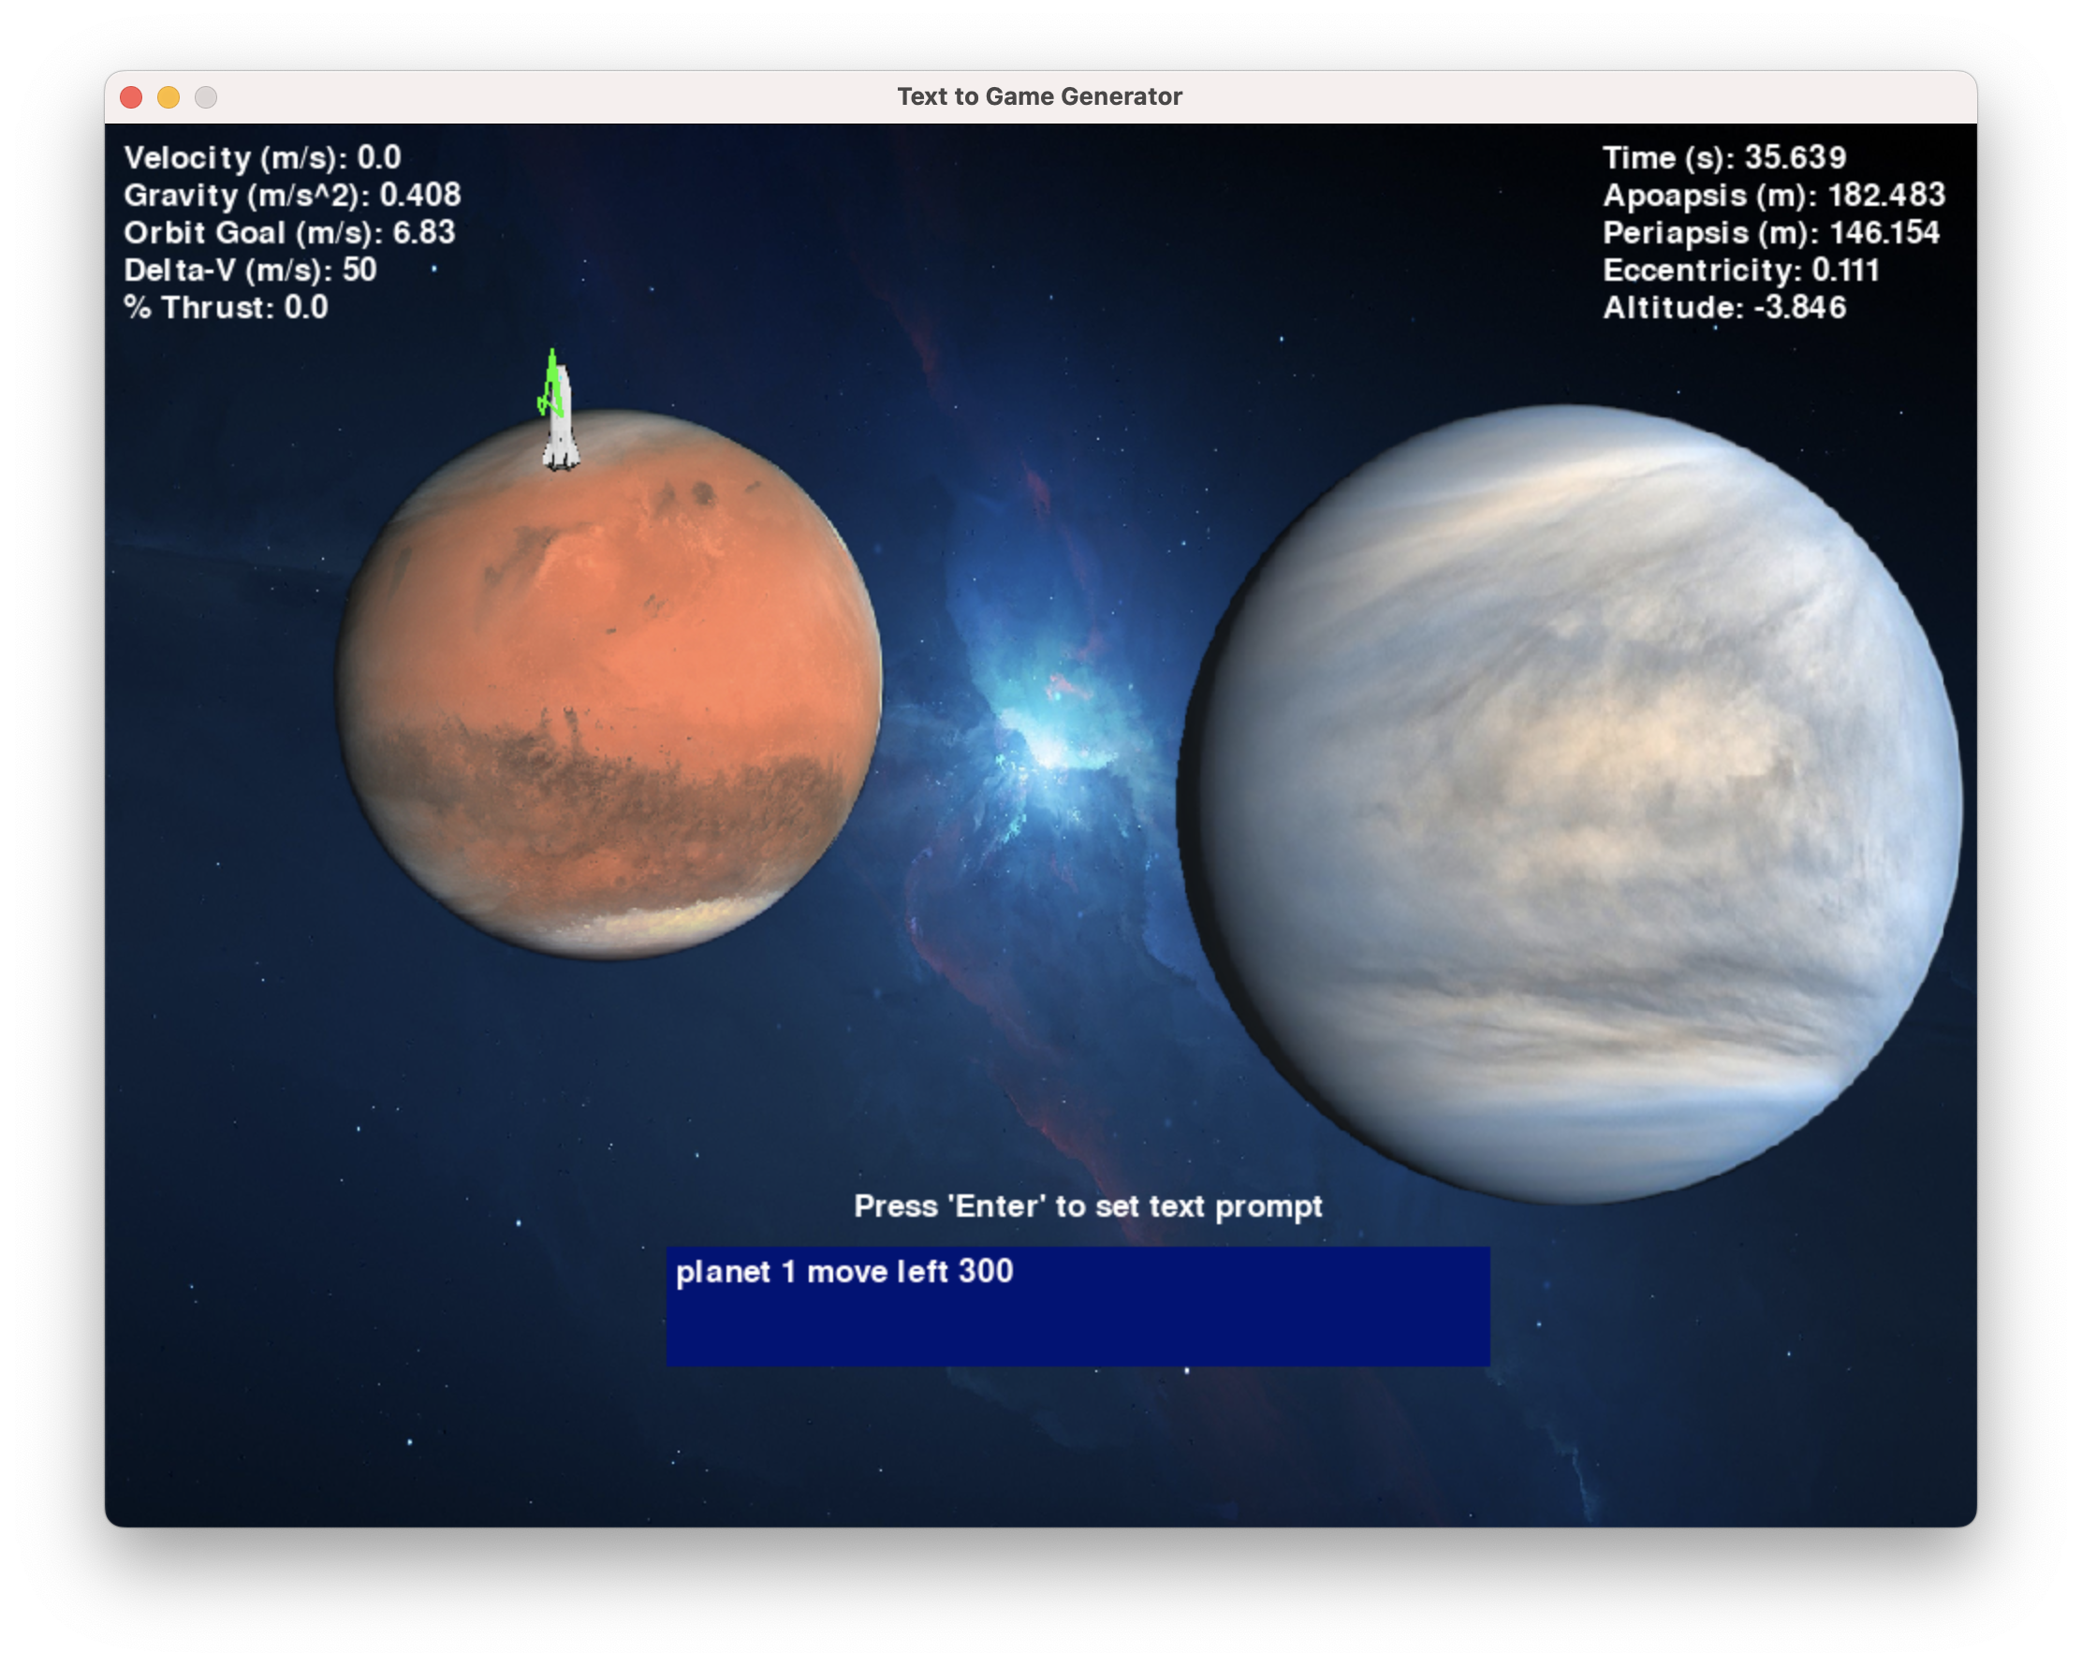
Hard-Coded Instructions
Runs 2D physics Planet Orbiter game using Pygame
Composed of modular programs:
Images.py: handles planet and background images
Orbits.py: traces orbit of spacecraft
Planet.py: represents each generated planet object
TextGame.py: the main program file
Main program applies user input to enact changes to game
Project game randomized planet Mars
Mars moved 300 pixels to the left

Slide 9
Functions in Main Program
Main program sections:
Planet and spacecraft variables
While running loop
Spacecraft running variables
Physics calculations
Hard-coded planet alteration instructions
Planet object ‘Planet.py’ file instances are saved into a list of planets
The spacecraft’s orbital parameters are based off first planet on the list
The list of hard-coded instructions applied to every planet
Move planet up, down, right, or left
Alter radius of planet
Alter mass of planet
Planets can be referenced as planet 1, 2, 3… etc

Slide 10
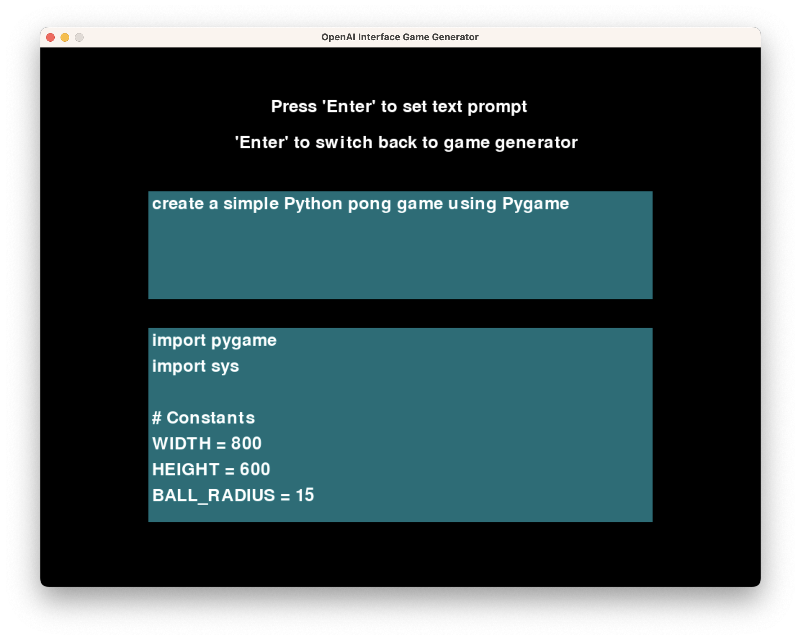
OpenAI Interface
Uses OpenAI library to send prompts to ChatGPT
Uses API key to access ChatGPT
Functions in program:
Return_code variable
TextChatCode()
Is_valid_code()
Text box user input
Accompanying programs:
Invalid code program ‘Invalid.py’
Pong test game ‘BaseGame.py’
Saved output ‘ModifiedTextGame.py’
Project game randomized planet Mars
Prompts ChatGPT to create a simple Pong game

Slide 11
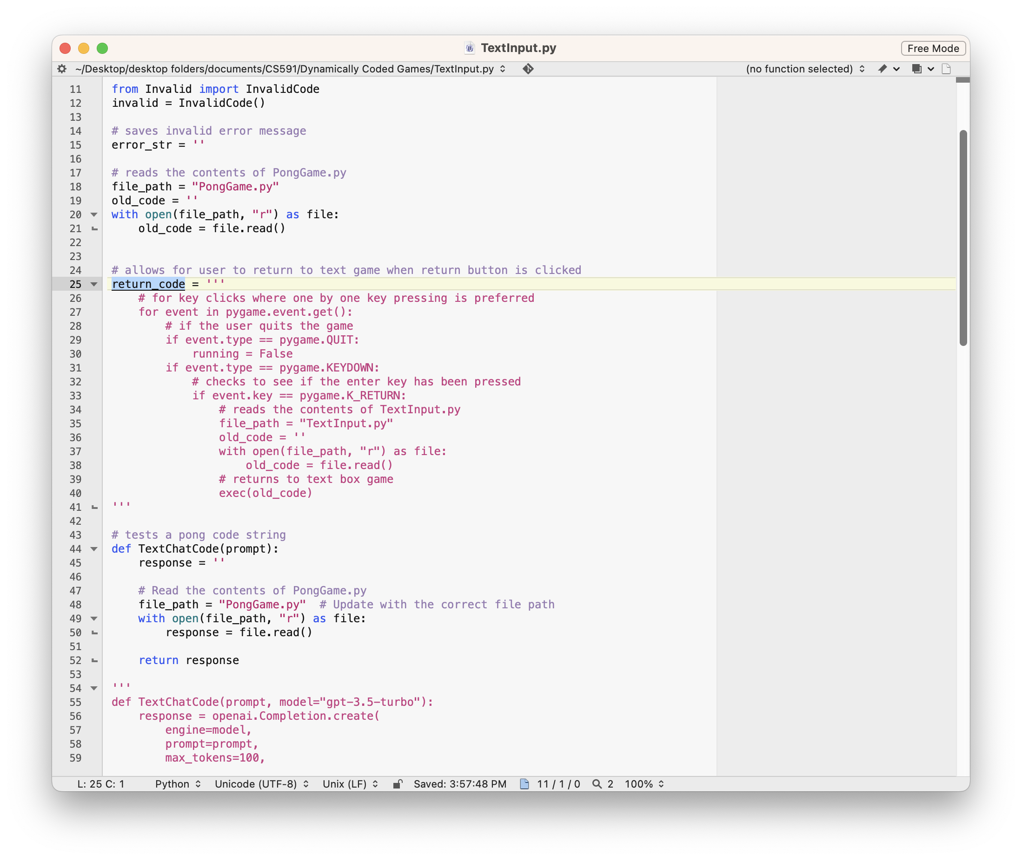
Return Code Variable
Return code initialized as multi-lined string
Allows generated game to return to TextInput.py file with ‘Enter’ key
Appended to game generated game string ‘response’
Exec() command used to run the modified game

Slide 12
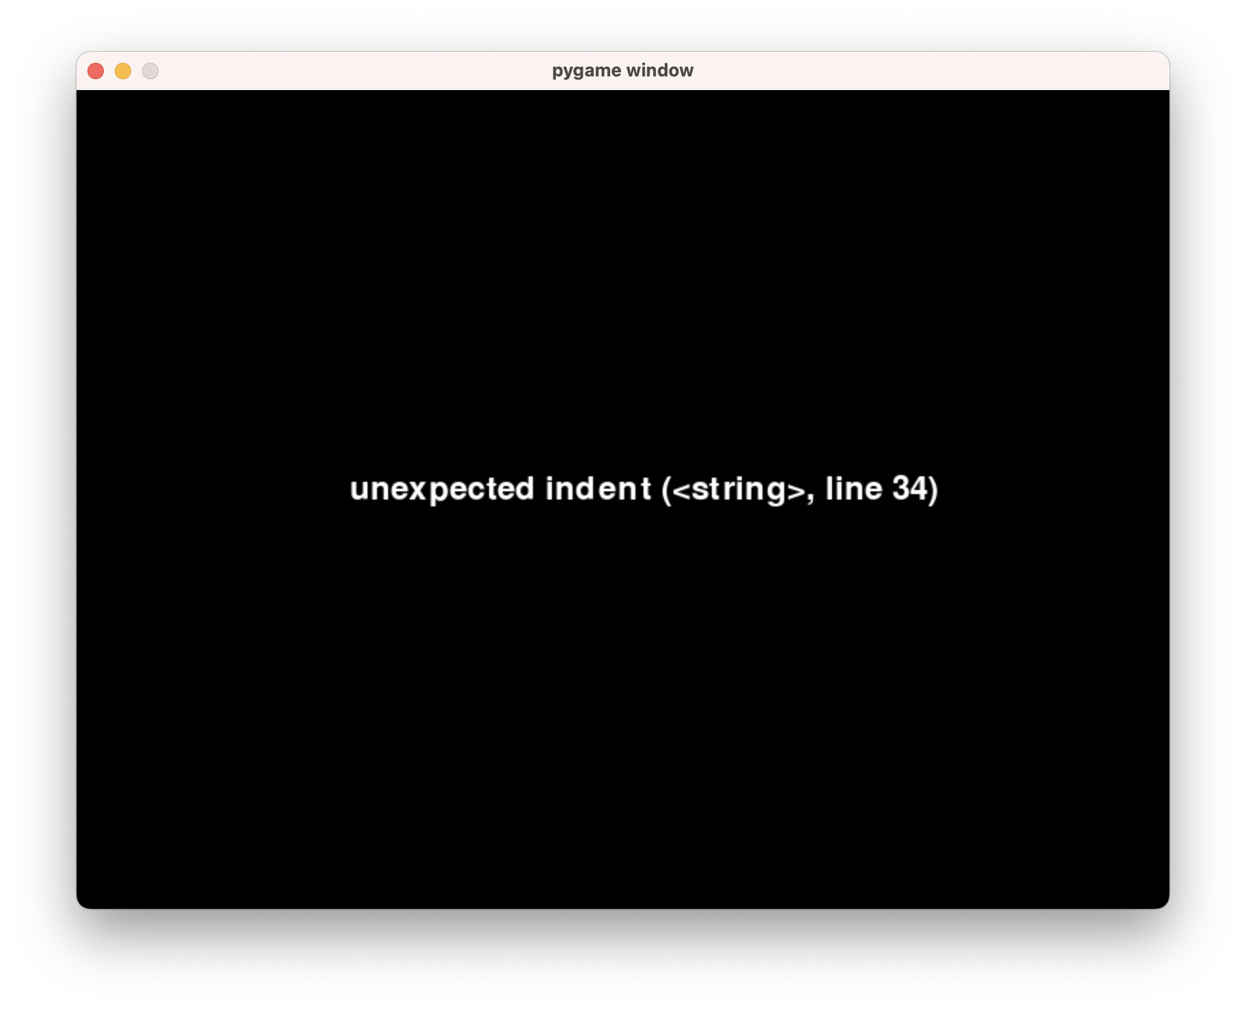
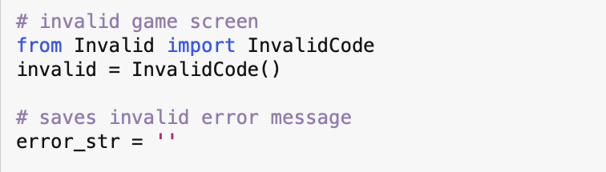
Invalid Code Program
Invalid class code contained in ‘Invalid.py’ file
Functions in class:
Set_error(): sets the error message string
Run(): runs a Pygame instance that displays the error message string
Runs when the generated game has invalid code

Slide 13
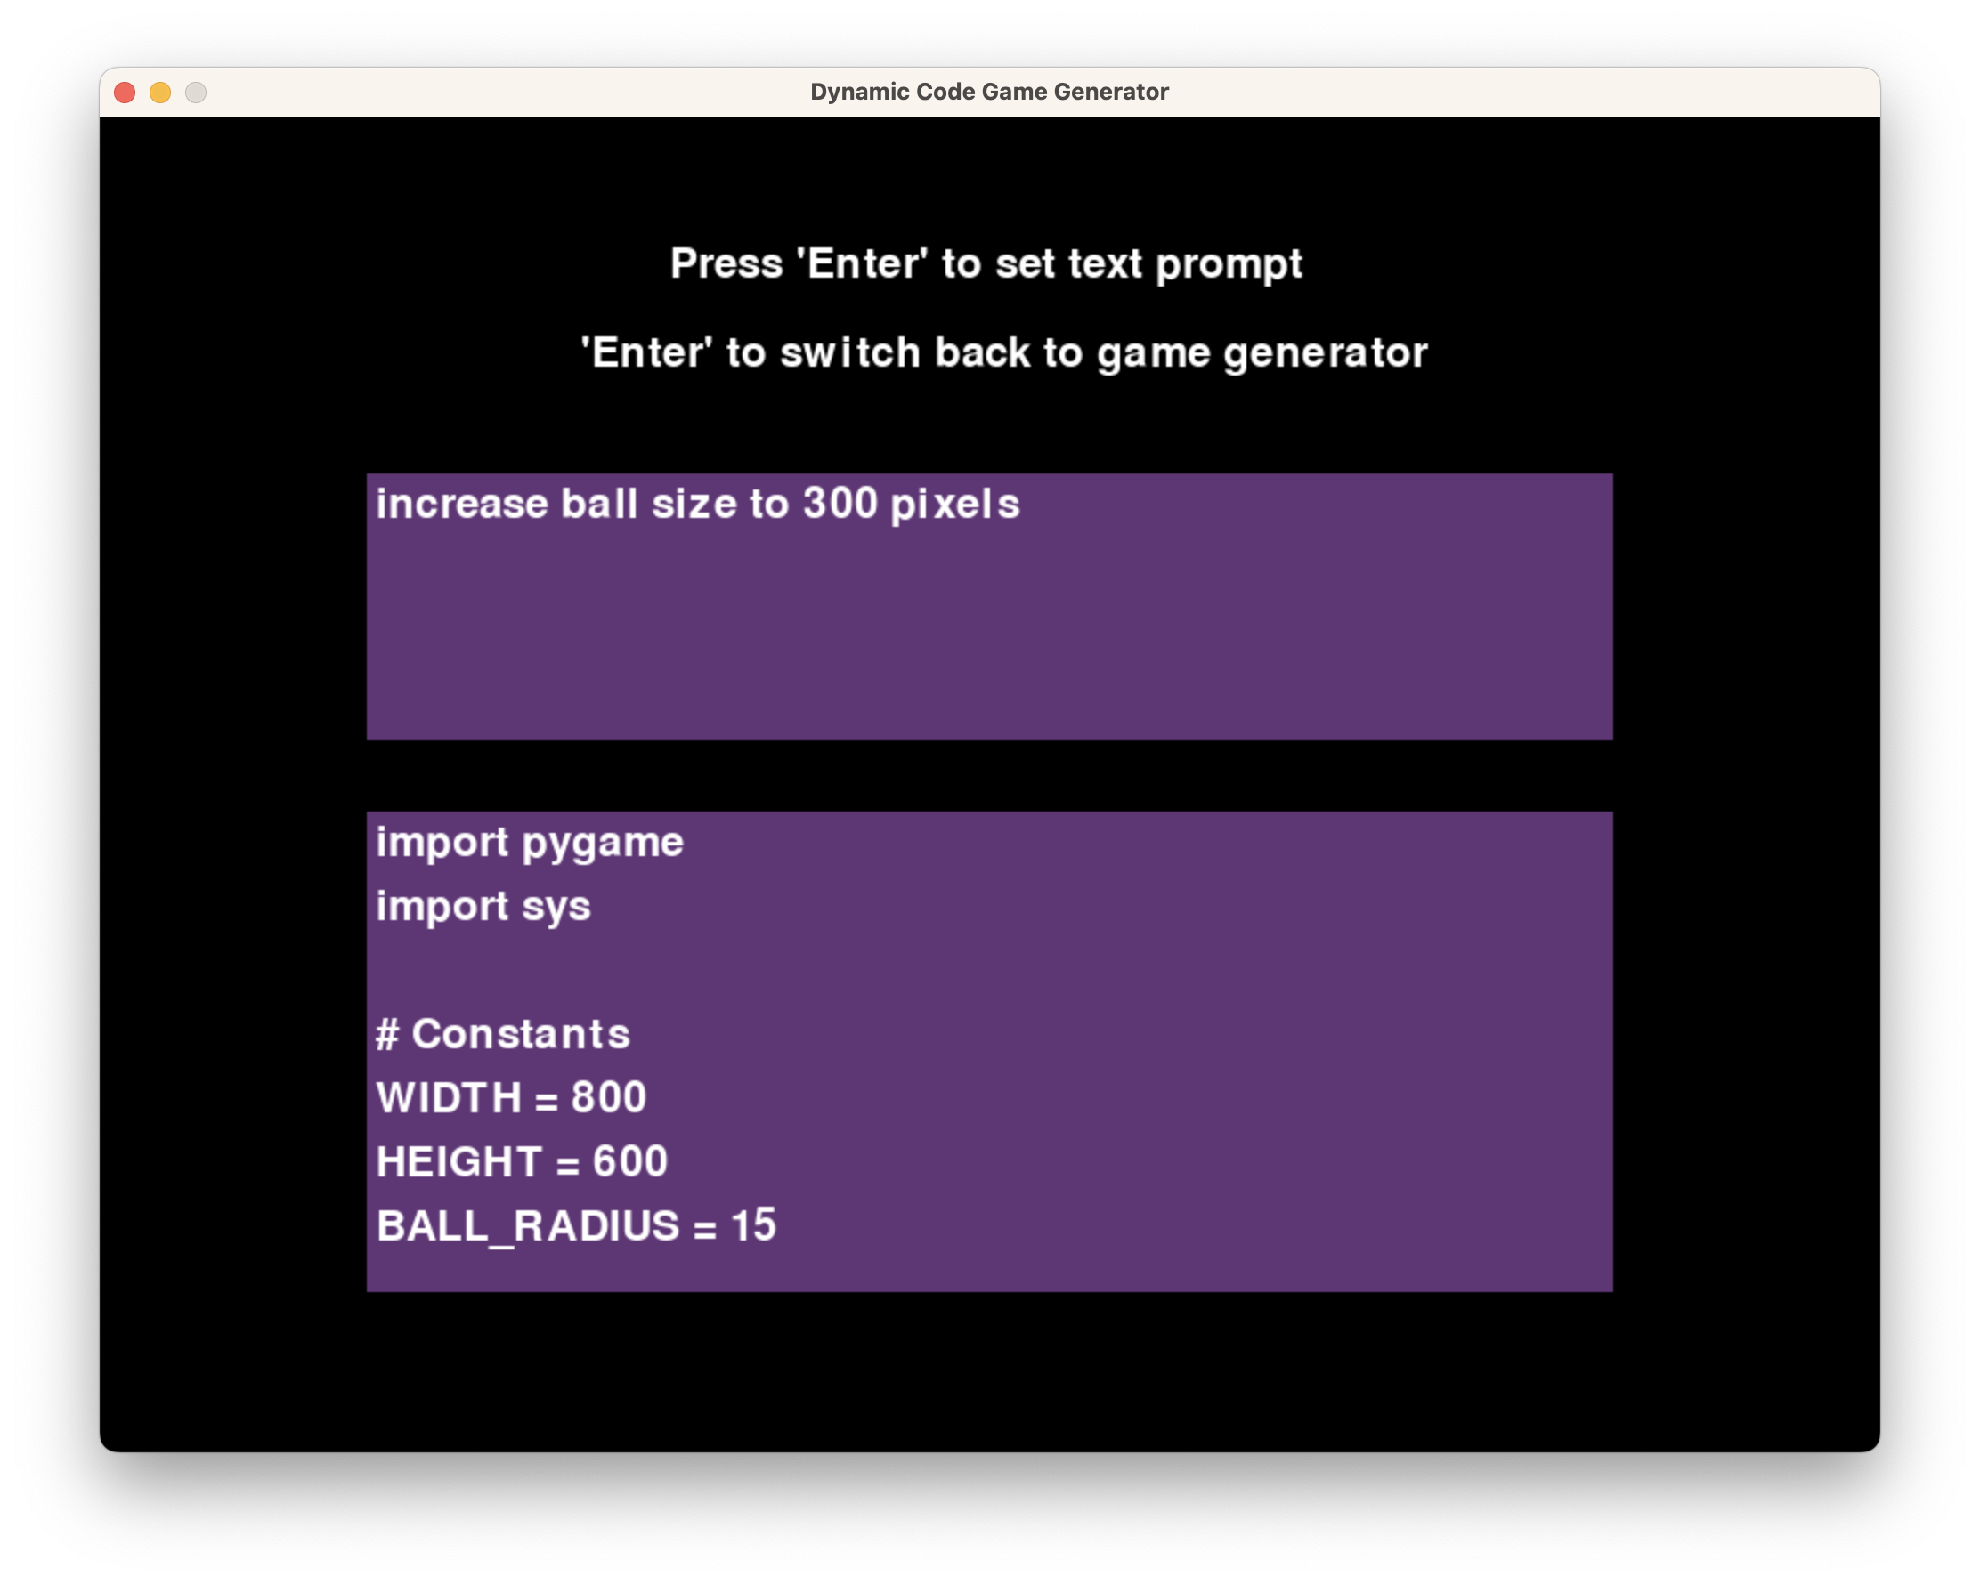
Dynamic Code Editing
Loads existing Pong game as a mutable string
Functions in program:
Return_code variable
Old_code (Pong) variable
Is_valid_code()
Text box user input
Game editing instructions
Accompanying programs:
Invalid code program ‘Invalid.py’
Pong test game ‘BaseGame.py’
Saved output ‘ModifiedDynamicGame.py’
Project game randomized planet Mars
A command to increase the ball radius to 300 pixels

Slide 14
Instructions in Dynamic Code
The return code variable is added to the base Pong game before modifications
The list of hard-coded instructions
Move racket up, down, right, or left
Change color of background, racket, or ball
Alter velocity of ball or rackets
Add variables or modify existing variables
The user input is saved as a string variable called ‘user_text’
One for-loop searches for the game object (racket, ball, etc) that will be modified
Every instruction is assigned a pre-fabricated code snippet
Another loop applies the code snippets to the appropriate lines
Project game randomized planet Mars

Slide 15
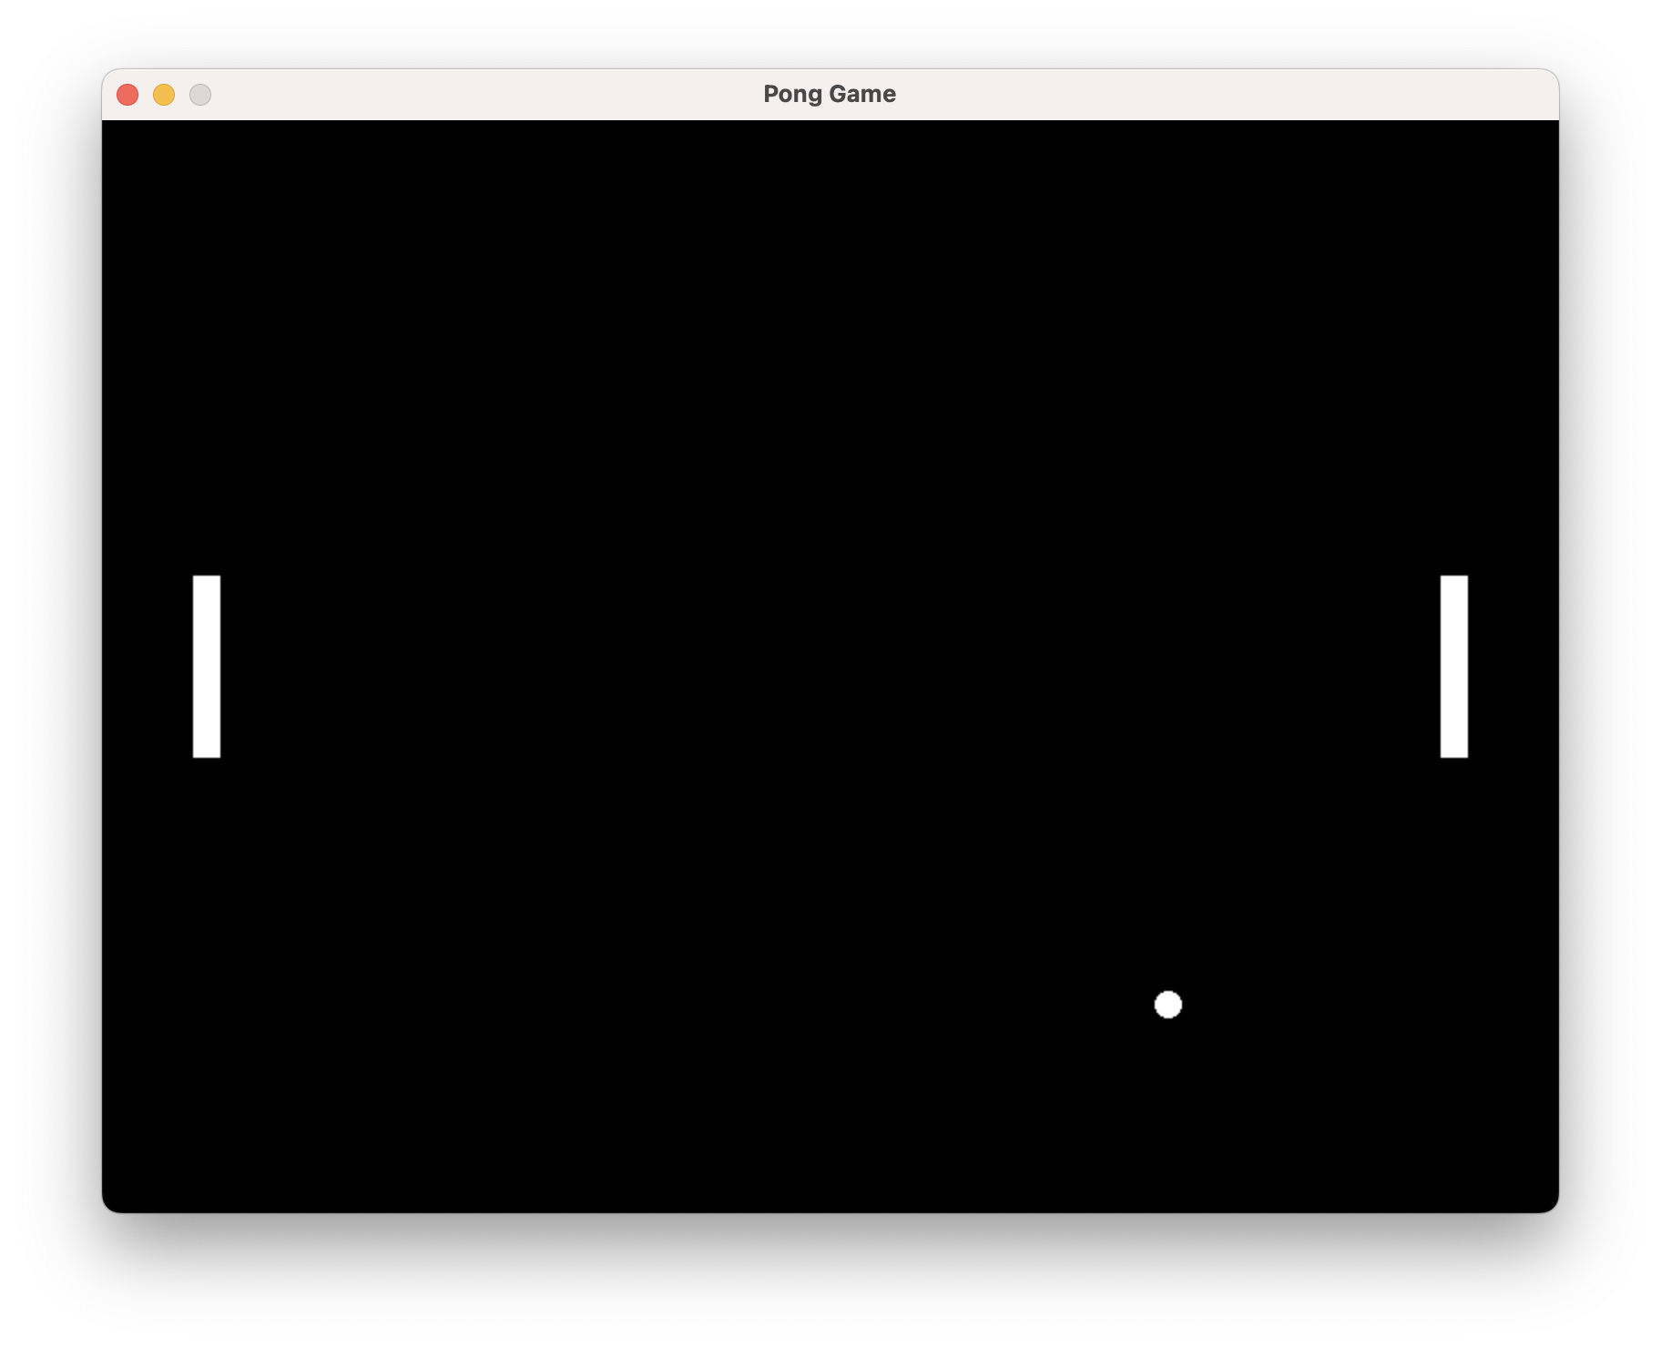
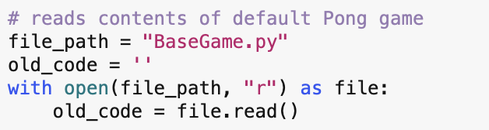
Pong Base Game
Default game for dynamic code generation engine
Test game for OpenAI interface generation
Contained in ‘PongGame.py’ file
Loaded in as string and then modified as needed

Slide 16
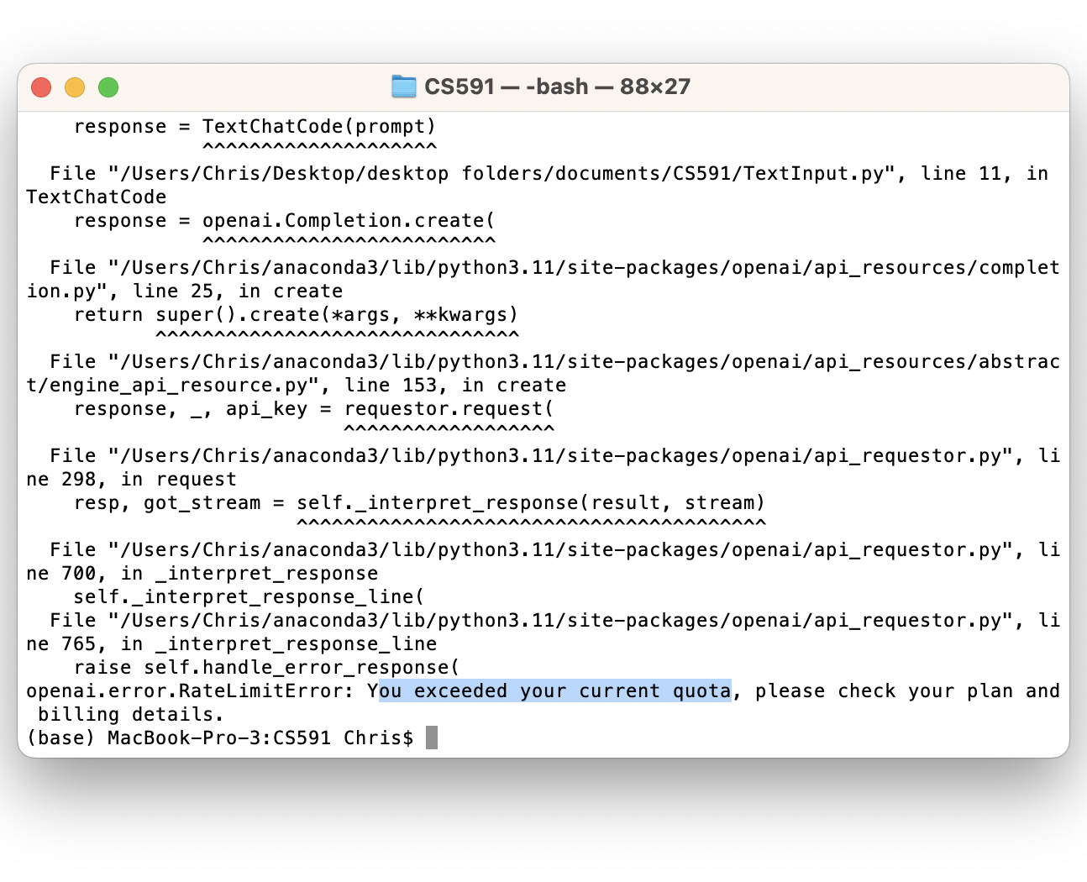
Current Progress
The hard-coded game generator works reliably
The OpenAI game generator works for the most part
Dynamic code progress
Edits code on all-caps variables
Struggled to make large scale edits
Room for improvement
Alter dynamic code generation to allow for insertion of new functions
Find alternate API system that does not require payment
ChatGPT API use limit reached

Slide 17
Conclusion
Three generation methods:
Hard-coded instructions
OpenAI interface
Dynamic code editing
The hard-coded game generation program is the least versatile method
The OpenAI interface generation is the most versatile but requires payment
Pros/Cons of dynamic code editing:
Allows for editing of existing code
More versatile than hard-coded instructions
Can be used without any paid API plans
Downside, does not use an openAI to generate games

Slide 18
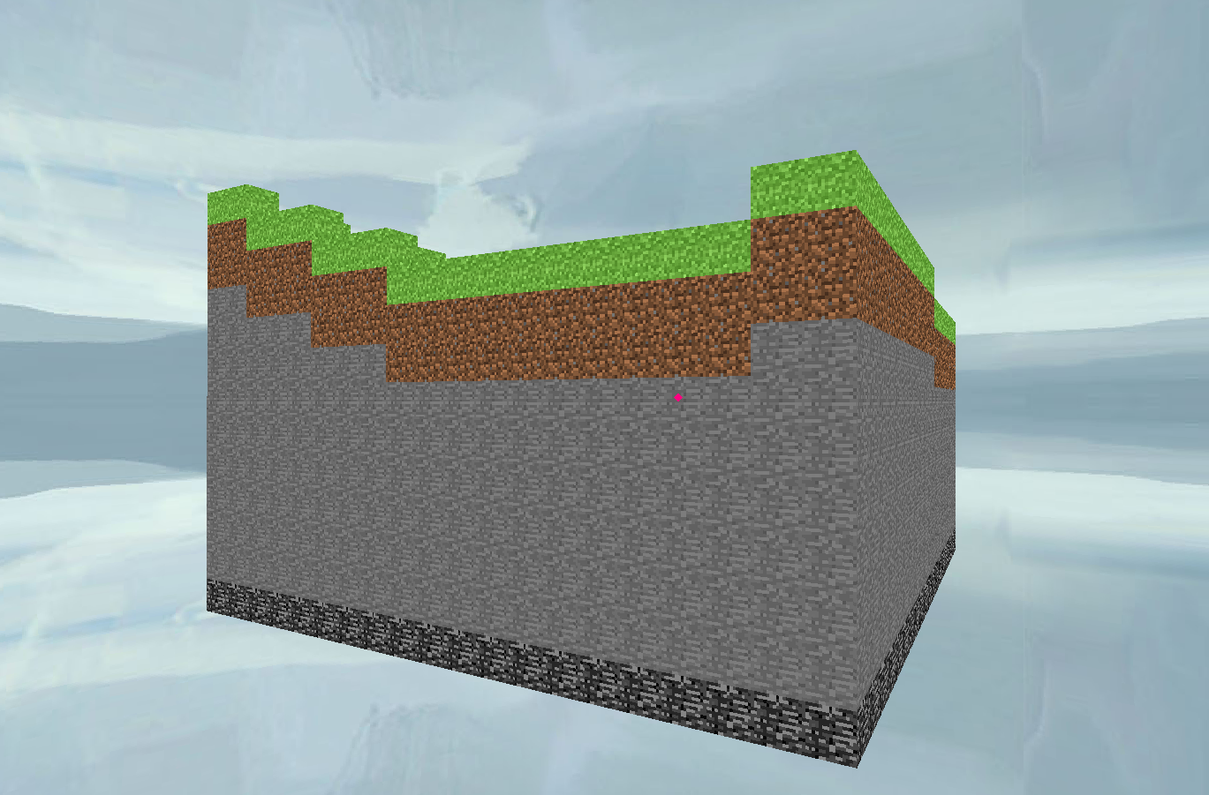
Future Work
Plans to expand to 3D game ChatGPT generation
Use a combination of an API interface and dynamic code
Use Python for game engine
3D Python game libraries
Ursina
PerlinNoise
OpenAI
Godot 3D solar system
Minecraft clone made using Python’s Ursina library

Slide 19
Sources
[1] Orbital physics equations: https://oer.pressbooks.pub/lynnanegeorge/chapter/chapter-1/
[2] Apoapsis and periapsis: https://orbital-mechanics.space/the-orbit-equation/orbital-nomenclature.html?utm_source=hashnode&utm_medium=hashnode+rix&utm_campaign=rix_chatbot_answer
[3] Input textbox: https://www.geeksforgeeks.org/how-to-create-a-text-input-box-with-pygame/
[4] ChatGPT API: https://blog.enterprisedna.co/how-to-use-chatgpt-for-python/
[5] Alpaca AI Chat program: https://www.listendata.com/2023/03/open-source-chatgpt-models-step-by-step.html
[6] ChatGPT research article: https://www.sciencedirect.com/science/article/pii/S266734522300024X

